Slide 1
Portfolio Diversifier
Identify potential diversifiers based on standard and cutting edge ratios
Analyze the impact of these diversifiers

Slide 2
Diversifiers Analyzed
tlt 20+ Year Treasury bond ETF
shy 1 to 3 Year Treasury bond ETF
gld Gold ETF

Slide 3
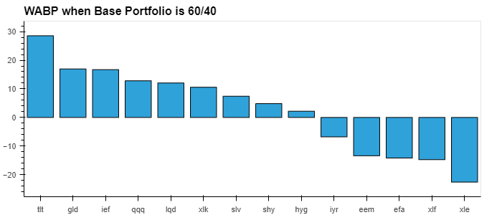

Slide 4
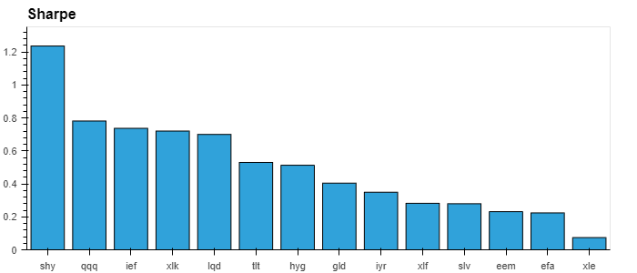

Slide 5
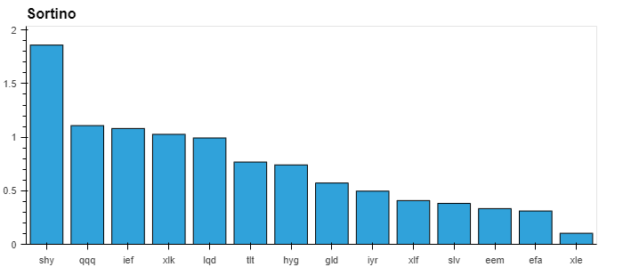

Slide 6
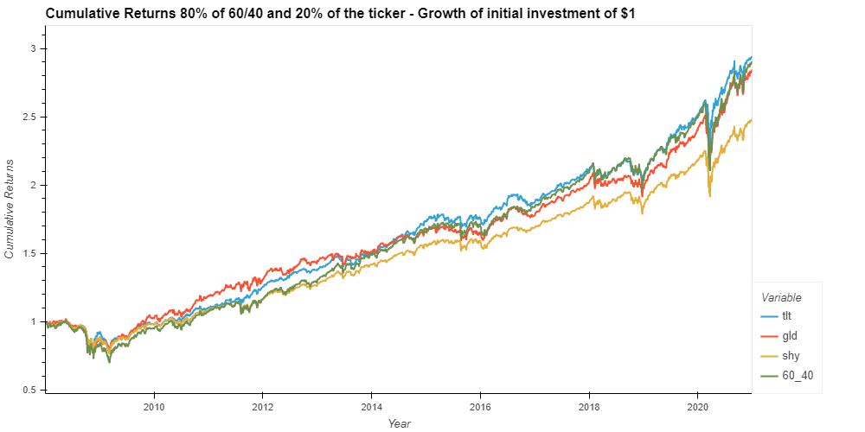

Slide 7
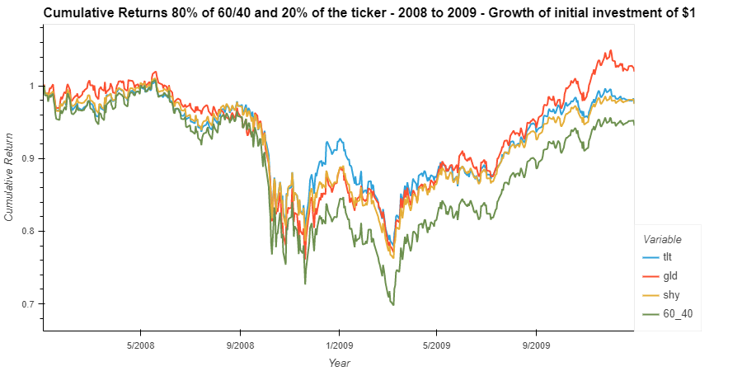

Slide 8
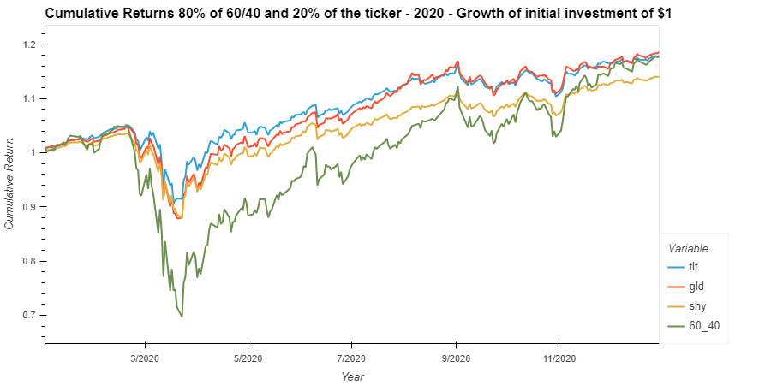

Slide 9
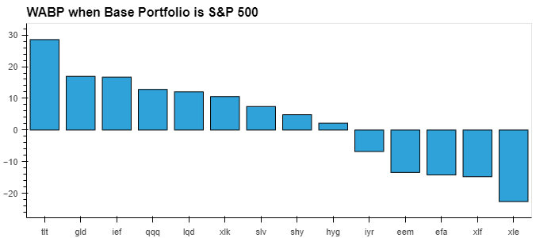

Slide 10
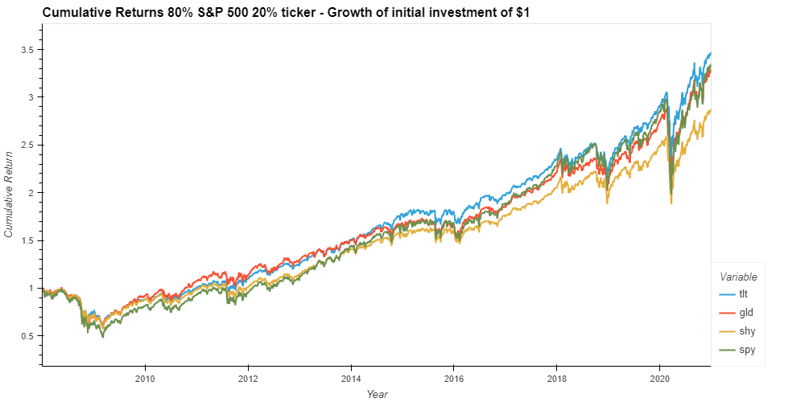

Slide 11
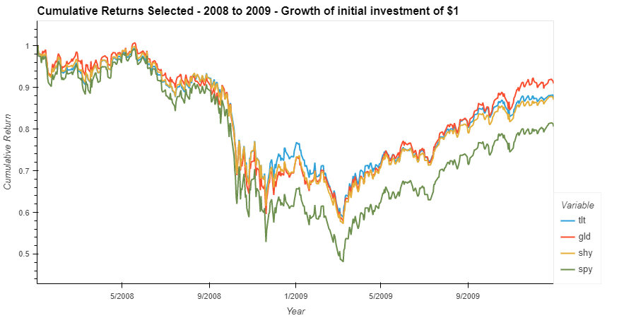

Slide 12
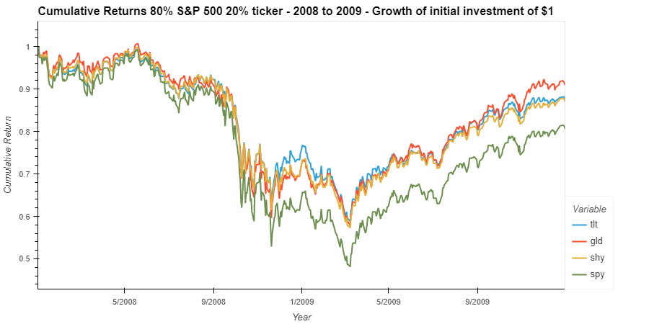

Slide 13
